Slide 1


Clinical Reasoning in Medicine
: A team affair
Dr John Willison
Discipline of Higher Education
School of Education

Slide 2
Purpose of this session
For you to internalise the answer to the questions:
What characterises the move from ‘following formulas’ to ‘clinical reasoning’?
What are the dynamics of effective team function?

Slide 3
Plan for today
You will:
consider a scenario
analyse how you probe this scenario
identify the skills you use to do it
characterise your team effectiveness

Slide 4
Questions for consideration (p.5 handout)
What is a heart attack?
What is the medical terminology for a heart attack?
What (in overview only) is/are the causes of a heart attack?
What constitutes a person’s “risk” of having a heart attack?
Is it age?
Is it gender?
What is the definition of a “risk factor”?
What are the risks for a heart attack? Are the risks things that can be changed or cannot be changed?
What other information will you need? What history questions will you need to ask him in order to assess his risk, ie is he healthy?
Does he have a healthy life style?
Generate a list of questions to assess his health status and why you think each question is important to ask.
(eventually you will need to generate these “thought” questions yourself) !!!!!!!

Slide 5
A lost man with memory loss…
… is found by a shopkeeper in front of her shop.
The shopkeeper and the man do not know each other.
The man does not remember his name or where he lives. He is not carrying any identification.
The shopkeeper is able to help the man get home.
How?
Pose and write questions that you can ask me (as an observer of events) to help you find out.
Your group needs to generate and write as many questions as possible in 4 minutes (think broadly).
Groups will call out qs, and I will organise them.

Slide 6
Who? | Has someone reported him missing? 1 Is there anyone else in the shop who knows him? 2
What? | Does he have any id features eg tats? 1 What is his clothing like eg uniform? 0 Does he have a phone? 0 Does he have any medication? 0 As the observer what did you see? 1
How? | How did he get there? 5 How big is the town? 0
When? | What time of day? 0 As observer, what do I know? How did the shop keeper help? AS obs, what do I know the shopkeeper did? Was he walking a dog? What is last thing remebers?
Where? | Does he remember the last place that he was? 5 Was he homeless? Has she been to his home? Does he have a receipt from the shop?
Why? | Does he know why he might have been there? 0
 | Does he speak English?

Slide 7
Most Informative First Question?
Read all the questions
Argue in your team for the question that will be the best starting question
Have a person nominated to vote and to defend why you would ask that one.
You will pose the top 5 questions to me, to see how far we get towards answering the question ‘How did the shopkeeper help the lost man get home?’

Slide 8
What skills did you use to do that first activity?
Facets of Clinical Reasoning | Your Analysis
Embark: identify, clarify, hypothesise | Forming hypotheses Asking questions
Find & Generate | listening
Evaluate & Reflectt | Reflection
Organise & Manage | Teamwork Prioritising, time management
Analyse & Synthesise | Logic- putting self in sit and think what you’d do Lateral thinking reasoning Imaginative visualisation Creativity, interpretation
Communicate & Apply | Communication- within group –everyopne speaks, phrasing of qs,, asking writing, body language
 | Learning testing hypotheses, empathy, being resourceful

Slide 9
Manage the process: Team Function?
Answer the following questions in your group. If your tutor is with you, they will listen to your answers, and then give feedback too.
What was the range of preparedness of individuals for yesterday’s session?
What are the implications of the answer to question 1?
For the following, consider yesterday’s CBL session and this session so far
To what extent did a person/a few people dominate? Why was that the case?
To what extent were some people not contributing? Why was that the case?
What are the implications of the answers for Qs 1-2?
Was listening active or passive? Provide specific examples of active listening if it occurred.
Did your group arrange in a configuration where everyone could participate? Would you change this configuration now?
Considering yesterday and today, did you act as a group of people or as a team?
Record answers, and pass to a tutor after answering the (hidden) questions 9 and 10. This sheet will be reviewed in a later CBL session.

Slide 10
Manage the process: Team Function
Q 9. Identify your team’s best strength.
Q10 Identify your team’s biggest weakness.
Be ready to call these out, and explain why these characteristics are vital in a medical context.

Slide 11
You engaged in these six facets of clinical reasoning yesterday
Prepare for session 1 by analysing the information you currently have relating to Mr Ramsay before session 1, based on the information you find in the pre-reading.
On the basis of that information does he have any risk factors for a heart attack?
What hypotheses could you generate based on the information you already have?
In session 1 when you have identified further information or history you will need from Mr Ramsay you will be able to refine your hypotheses. Think about this process as you do your reading.

Slide 12
What is a hypothesis and how will you form hypotheses?
A hypothesis is: A proposition formed on careful consideration of data/evidence which explains a problem. In medical terms, this consists of a proposal for a medical condition that may explain the patient’s presentation (ie symptoms).
Hypotheses by definition can be incorrect and you will find this out by testing them.

Slide 13
Identify, clarify & hypothesise
Part 2 Case Preparation (continued) P.7
Try to form hypotheses, which would explain whether Mr Ramsay is at risk of a heart attack.
What have you read about in regard to possible risk factors for heart attacks?
Your hypotheses could be about Mr Ramsay's degree of risk.
Mr Ramsay is at risk of a heart attack because ………
Mr Ramsay is not at risk of a heart attack because …..
Mr Ramsay has a high risk of heart attack because……..

Slide 14
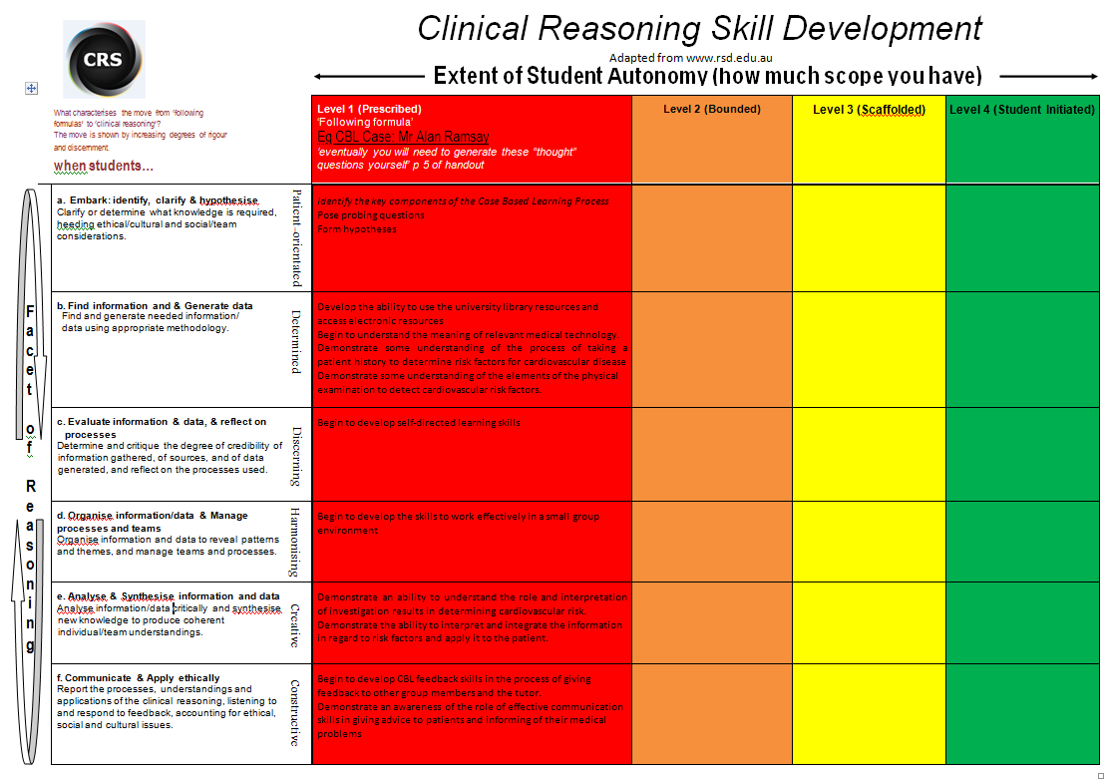

Slide 15
Early Explorer Survival
The explorer Edward John Eyre, accompanied by his Aboriginal guide Wylie, was the first [non-aboriginal] man to cross southern Australia from east to west, travelling across the Nullarbor Plain from Adelaide to Albany.
About 1000 km short of Albany, Eyre and Wylie survived near starvation after seven days by finding a native waterhole and killing and eating kangaroos.
http://australia.gov.au/about-australia/australian-story/aboriginal-trackers

Slide 16
Early Explorer Survival (cont)
Burke and Wills journey from Melbourne to the Gulf of Carpentaria in Australia's far north, did not include Aboriginal guides.
The account from the sole survivor, John King, records the explorers' hostility at offers to trade food for handkerchiefs from Aborigines along the Darling River.
Oral history from Aboriginal descendents records the horror of the tribes-people at the expedition's caravan of oxen, bullocks, camels and horses drinking waterholes dry and removing all the heavy grinding stones from camp sites.
Both the leaders of the expedition, and all-but-one of the others, died on this ill-fated expedition.

Slide 17
Indigenous Reasoning vs Clinical Reasoning

Slide 18
What are the similarities and differences between ➔ aboriginal reasoning skills ➔ clinical reasoning skills
Similarities | Differences
2 Minutes: Group with the most reasons reads them out.

Slide 19
What did you do in that 2 minute activity? What skills did you use?
RSD Facets | Audience’s Analysis
A. Embark & clarify
B. Find & Generate
C. Evaluate & Reflect
D. Organise & Manage
E. Analyse & Synthesise
F. Communicate & Apply ethically

Slide 20
Purpose of this session
For you to internalise the answer to the questions:
What characterises the move from ‘following formulas’ to ‘clinical reasoning’?
What are the dynamics of effective team function?

Slide 22
Group or Team
Analyse:
From 0 (not at all) to 10 (exceptional) rate your teams performance yesterday
Top strength demonstrated yesterday
Greatest weakness
Then look at this in terms of facet D.
Move from ‘formula following’ to ‘clinical thinking’

Slide 23
Session Outline
You have research skill
Six facets of research
Levels of independent work in research
Benefits of explicit development of research skills according to Oral Health students
Transition across the Oral Health Program

Slide 24
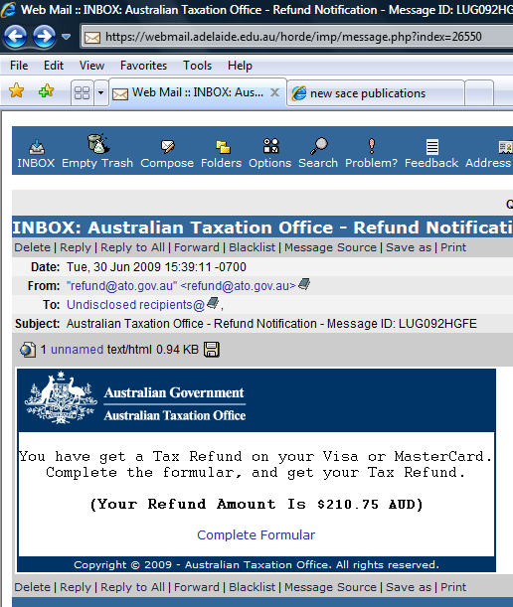

Slide 25
An Activity to Discern Research Skill
Should I click on ‘Complete Formular’ to get my tax return?
Each pair/trio has 2 minutes to list as many indicators of credibility as possible
positive indicators- reasons to believe
negative indicators- reasons to not believe
Group with the highest number of indicators reads them out.

Slide 26
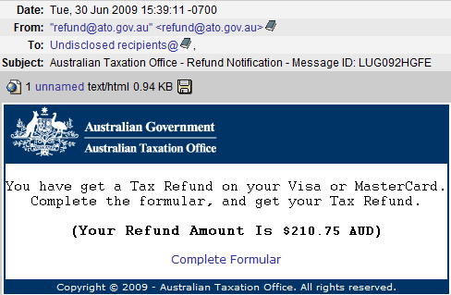

Slide 27
Six Facets of Research
All facets are utilised in:
literature/published data research
laboratory research
clinical research
field research
combined forms
discipline-based & interdisciplinary research
your social life
your family life

Slide 28
Degree of Independence in Research

Slide 29
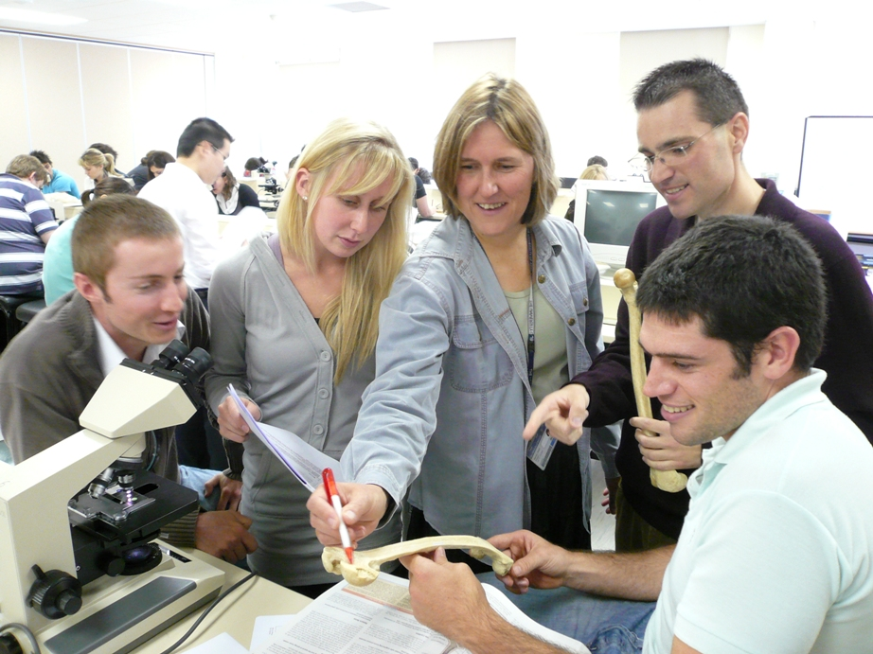
Students researching with a high degree of structure/guidance

Slide 30
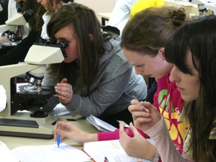
Students researching with some structure/guidance

Slide 31
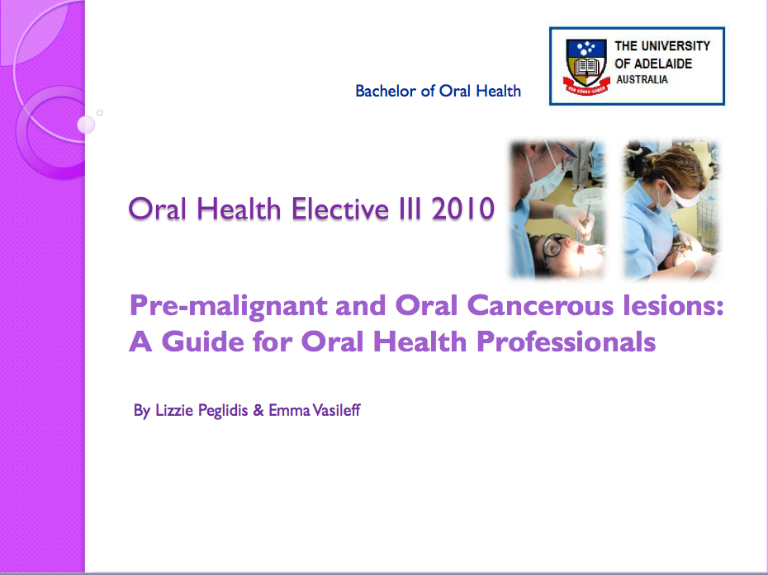
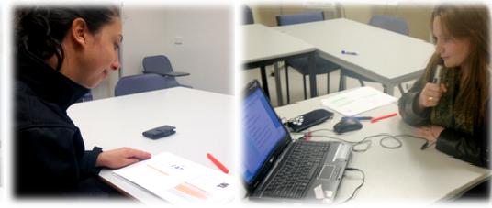
Students researching independently

Slide 32
The development of your clinical reasoning skills
This will happen best when you:
Are aware of the 6 facets explicitly
The facets sometimes left implicit in your studies
Build clinical reasoning skills incrementally
Don’t expect to be immediately brilliant. It takes time
Aim high, but in small steps
Perceive cycles of development
When you apply your skills in ‘harder’ contexts, you may seem to have gone backwards. You haven’t.
Aim to become increasingly independent

Slide 33
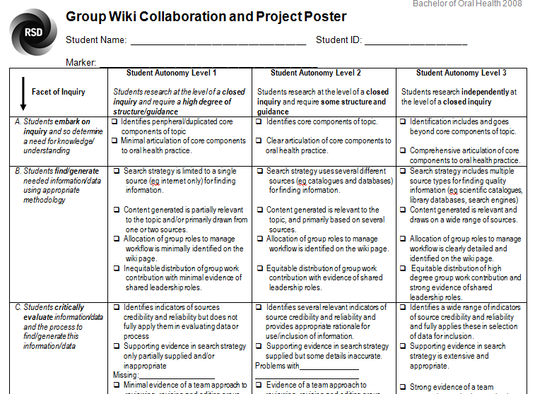

Slide 34
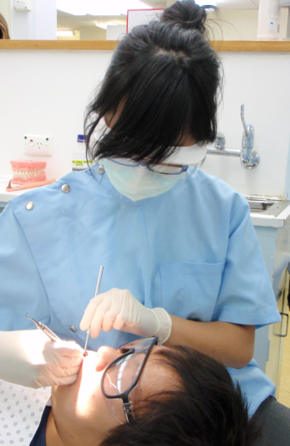
WHAT OUR GRADUATES SAY:
2010 BOH graduate 1 Year after completing the program
“Before I left for Cambodia, I actually took a silver fluoride … I was really looking into that because I thought that might be really beneficial for Cambodia because they don’t get care often and they’re considered more rural so I was doing a lot of research with that and I ended up purchasing some and taking it over with me and I was using it alot when I was over there.”

Slide 35

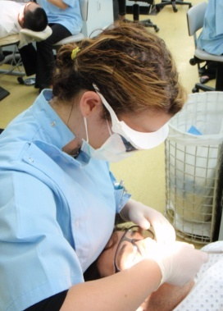
WHAT OUR GRADUATES SAY:
Another 2010 BOH graduate
“Well just being able to have a bit of a voice in the staff meeting full stop; like it’s nice to be able to listen to and particularly by the dentists. It’s nice just being able to give your ideas, your research, what you found and their (dentists) accepting of it, so it’s nice that way. I think it (research) helps with that as well because it’s just not what you reckon”

Slide 37
Affective Domain: Emotions & Motivations
Consider single-word descriptions of affect (motivations and emotions) for each facet.
Facet A: ‘students embark on an inquiry and so clarify a need for knowledge/ understanding
Phrase as ‘ ………………. (adjective) students’
e.g.Intense
Driven

Slide 38
Affective Domain
Facet A: Students embark, & clarify the knowledge that is needed
Curious
‘I am neither especially clever nor especially gifted. I am only very, very curious.’ Albert Einstein
‘It inspires something in you that makes you want to find out’
First Year Human Biology Student

Slide 39
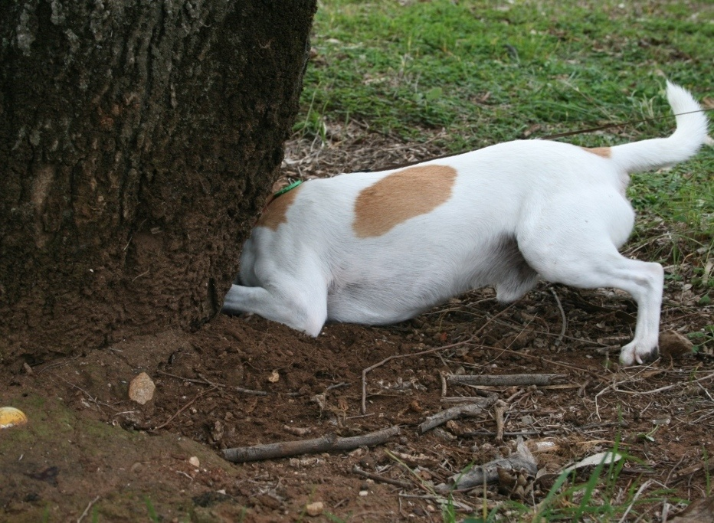
Decidedly curious…
… being in query

Slide 40
Affective Domain (continued)
Facet B: Students find & generate needed information using appropriate methodology
Determined
‘It's not that I am so smart. It's just that I stay with problems longer.’ Albert Einstein

Slide 41
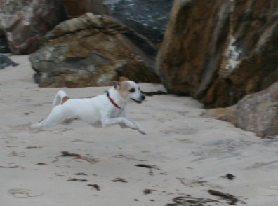
Determined to get there in the end…
Being determined puts the ‘re’ in research

Slide 42
Affective Domain (continued)
Facet C: students evaluate information/data and reflect on the research processes used
Discerning
"I think and think for months and years. Ninety-nine times, the conclusion is false. The hundredth time I am right. "
Albert Einstein

Slide 43
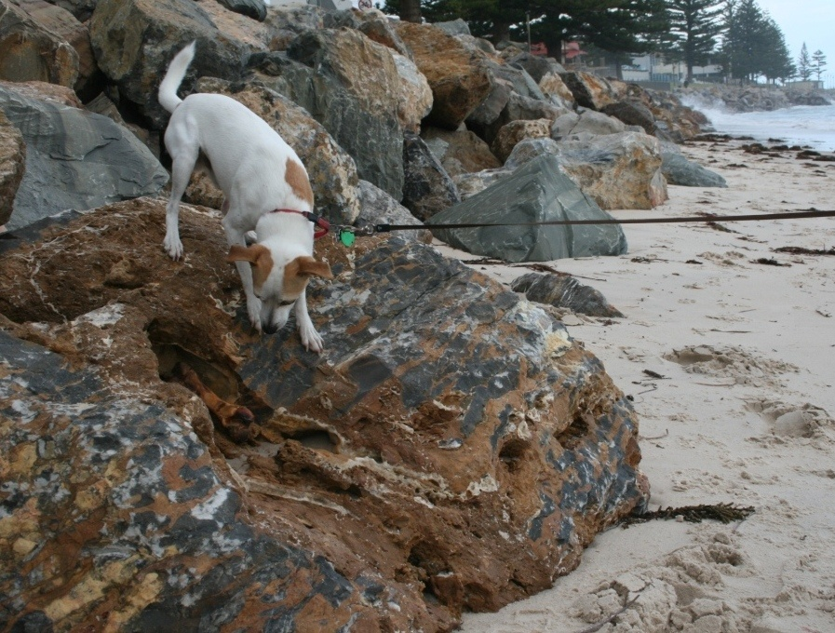
Discerning the valuable amongst the valueless

Slide 44
Affective Domain (continued)
Facet D: students organise & manage information collected/generated and research processes
Harmonising
Resonating with the data, making hidden patterns obvious
‘Out of clutter, find simplicity.’ Albert Einstein
Working harmoniously with people, processes

Slide 45
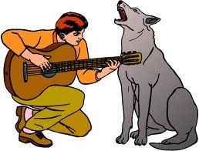
Harmonising
On song with inputs
In tune with people
Hound dog harmonising

Slide 46
Affective Domain (continued)
Facet E: Students analyse & synthesise information, data and new knowledge
Creative
Knowledge is limited. Imagination encircles the world- Albert Einstein

Slide 47
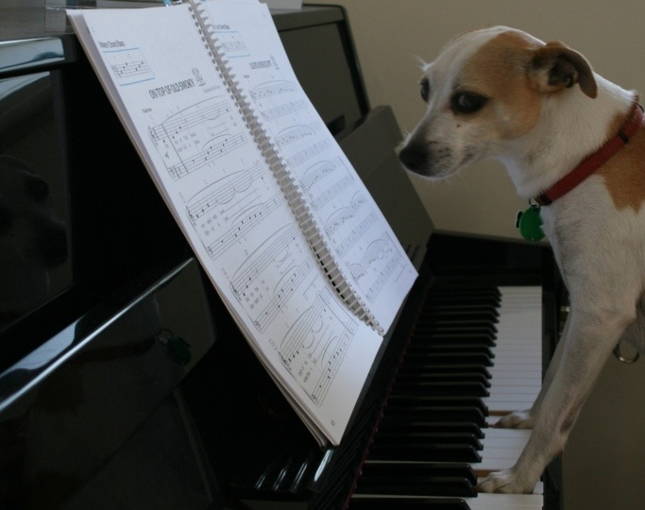
Creative

Slide 48
Affective Domain (continued)
Facet F: students communicate & apply understanding and the processes used to generate it, in an ethically, socially and culturally mindful way.
Constructive
‘Go to where the silence is and say something’ – Amy Goodman
"the greatest talent is the ability to strip a theory until the simple basic idea emerges with clarity." -- Albert Einstein

Slide 49
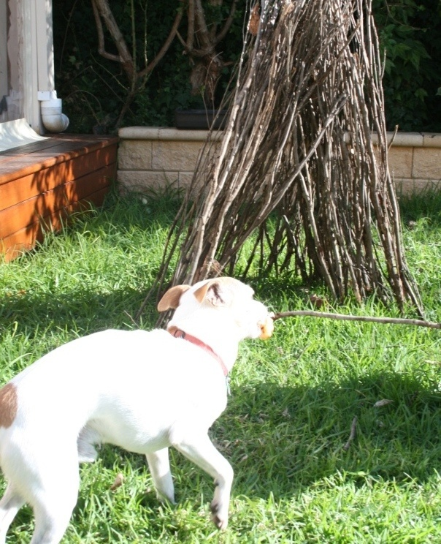
v
Constructive

Slide 50

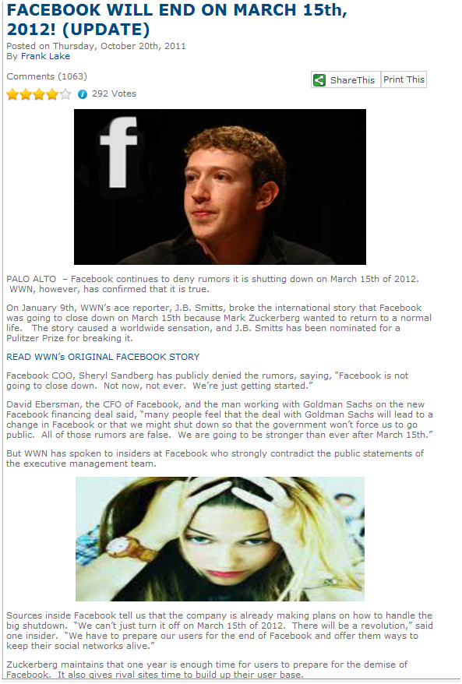

Slide 51
Which Facet?
Roll your 6 sided shape to determine which facet to focus on for this task
Your group has 2 minutes to focus on that facet as you decide if the webpage information is credible.
EG facet 1: how do you begin/ clarify?

Slide 52
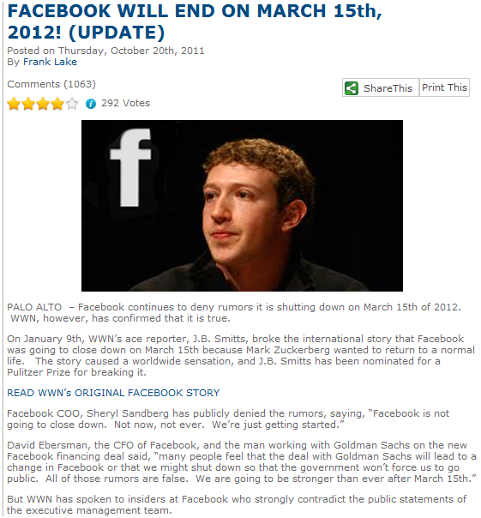
http://weeklyworldnews.com

Slide 53
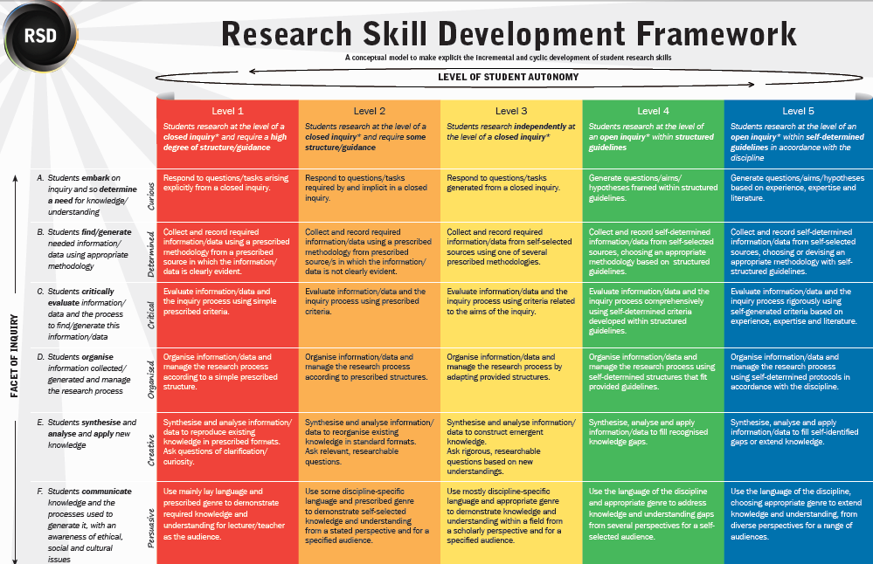

Slide 54
Web Site
www.rsd.edu.au
References
Willison, J.W. & O’Regan, K. (2007). Commonly known, commonly not known, totally unknown: A framework for students becoming researchers. Higher Education Research and Development 26 (4).
Acknowledgement
Some materials used in this session were developed through funding from an Australian Learning and Teaching Council Competitive Grant.

Slide 55
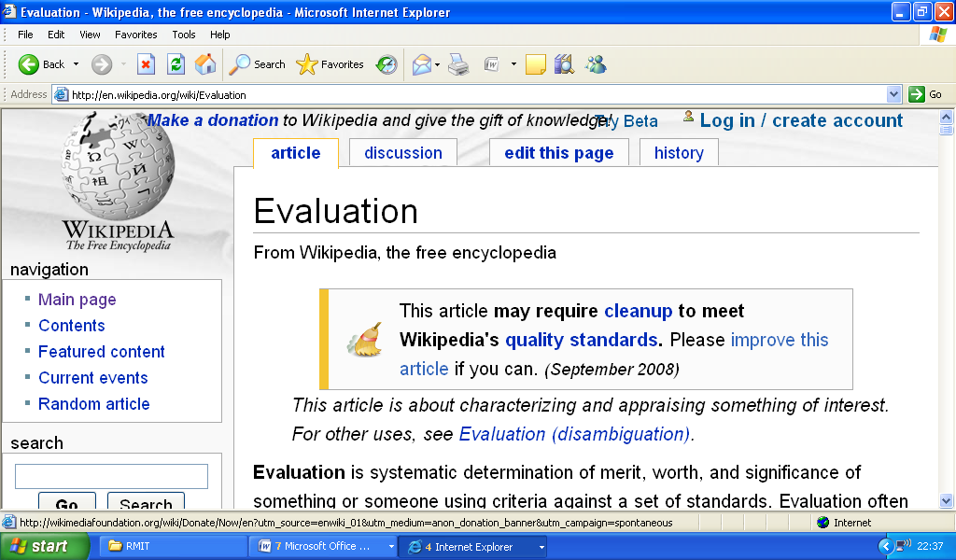
September 2008

Slide 56
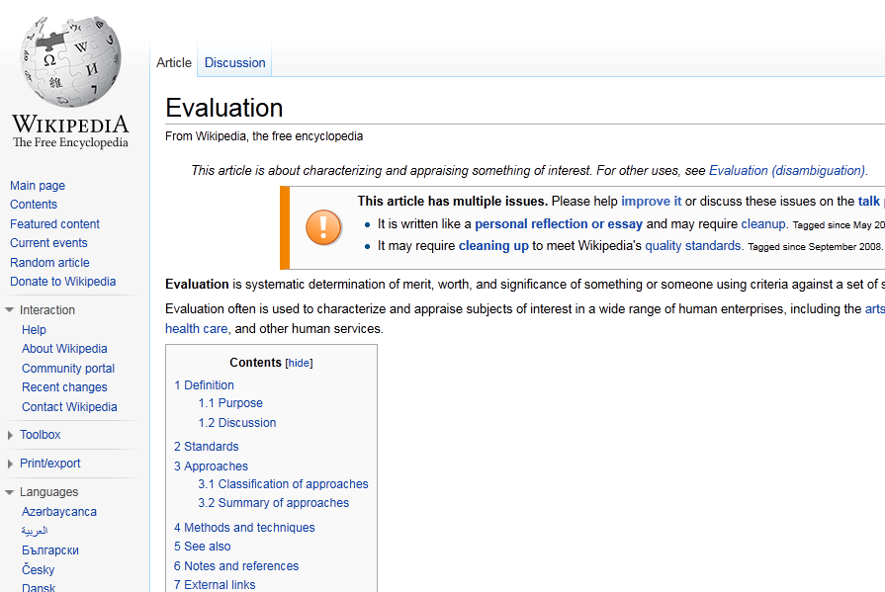
September 2011

Slide 57
The facets of student research
In researching, students:
embark on an inquiry and so clarify their need for knowledge/understanding
find/generate needed information using appropriate methodology
critically evaluate information/data and reflect on all processes employed
organise information collected/generated and manage research processes
Analyse and synthesise new knowledge
apply and communicate knowledge and the processes used to generate it,
… with an awareness of ethical, social and cultural issues.
(Willison & O’Regan, 2007)

Slide 58
What skills did you use to do that first activity?
RSD Facets | Your Analysis
Embark & Clarify | Brainstorming, posing questions, clarifying
Find & Generate | Using questions to find information. History
Evaluate & Reflect | Evaluating questions. Which question is most probing? Evaluating information- what is relevent?
Organise & Manage | Ranking question. Manage to involve minority voice? Team function
Analyse & Synthesise | Prioritising- which question most important
Communicate & Apply | Talking, gesticulating. Discussion mode, argument mode, listening

